Slide 1
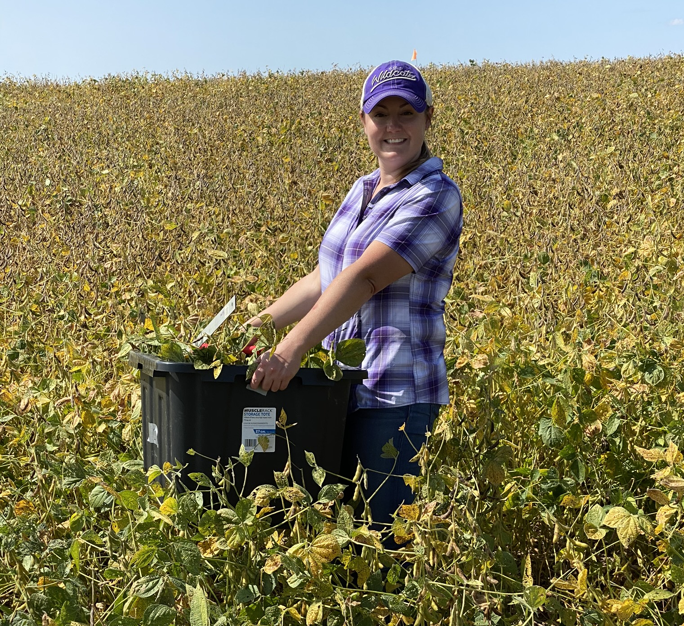
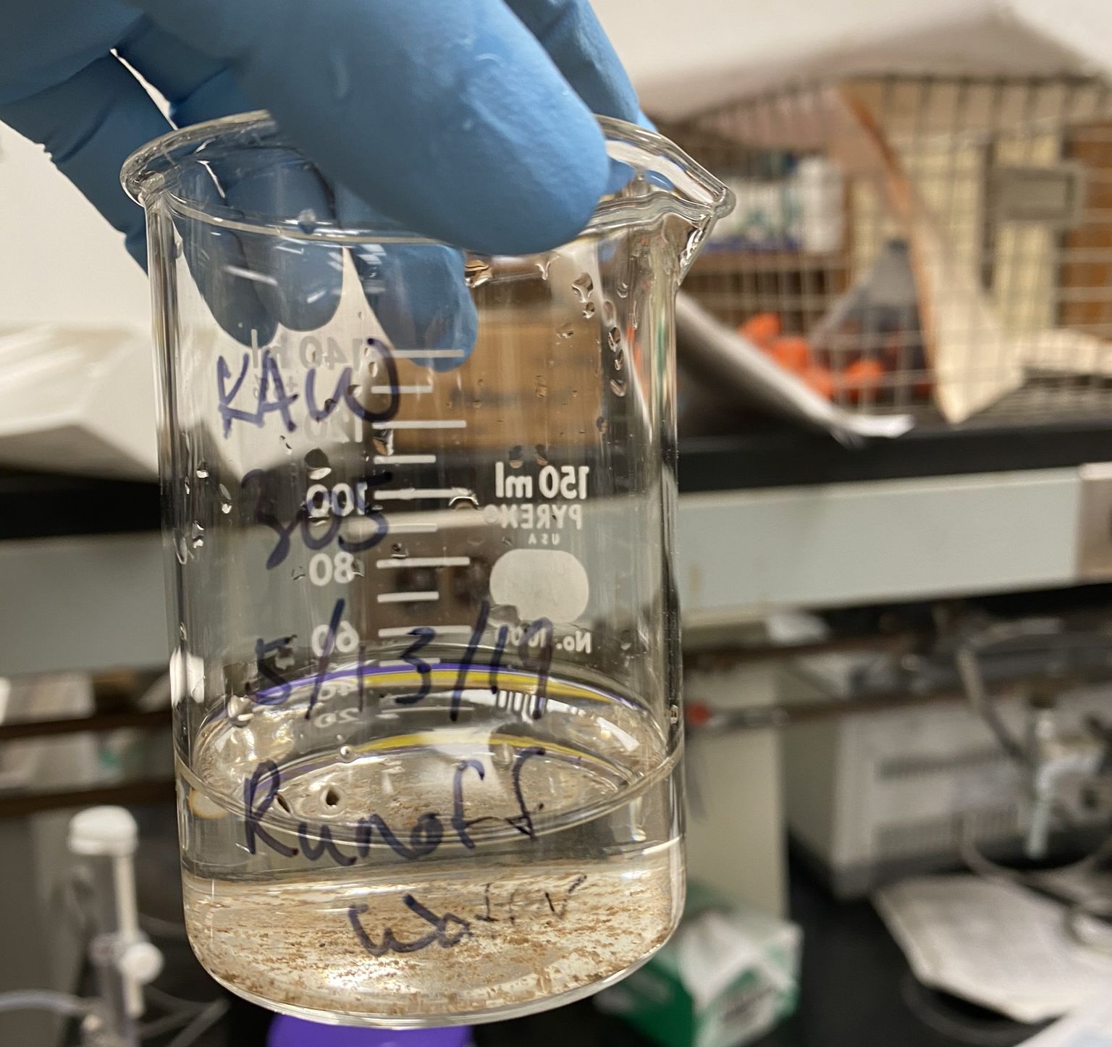
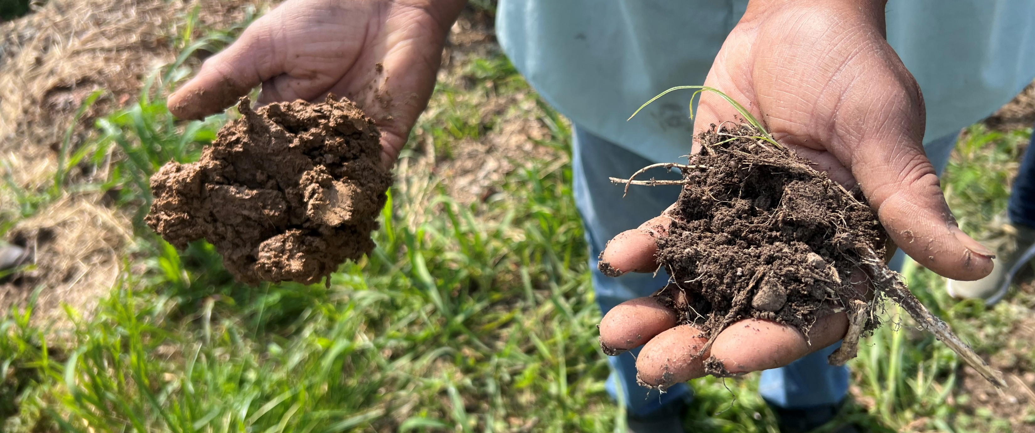
Soil Carbon Amendment Reports

Slide 2
Tests Required for All Carbon Amendments
Parameter | Range | Unit
Feedstock | Report1 | Type by %
pH | Report | pH units
Electrical Conductivity (EC) | Report | dS/m
Moisture | Report | %
Organic Matter/Carbon | Report | % DW2
Total Nitrogen | Report | % DW
Particle Size | Report | % per size class
Phosphorus | Report | mg/kg4 DW
Potassium | Report | mg/kg DW
Calcium | Report | mg/kg DW
Magnesium | Report | mg/kg DW
Arsenic | <41 | mg/kg DW
Cadmium | <39 | mg/kg DW
Copper | <1500 | mg/kg DW
Lead | <300 | mg/kg DW
Mercury | <17 | mg/kg DW
Nickel | <420 | mg/kg DW
Selenium | <100 | mg/kg DW
Zinc | <2800 | mg/kg DW
1Report results, also see criteria under amendment type. 2DW = Dry weight. 4milligrams per kilogram (mg/kg) = parts per million (ppm) = grams per ton (g t-1)
A low EC indicates that biochar is low in soluble
salts and vice versa.
Amendments made with manure may have higher salts and higher nutrients

Slide 3
Tests Required for All Carbon Amendments, continued
NRCS standards for biochar include a range of maximum
allowable concentrations for metals based on a review of
regulatory values, however, state and local regulations may be more stringent
Some metals (e.g., arsenic, chromium, mercury) are
phytotoxic and/or pose human health hazards, while other metals are plant micronutrients (e.g., nickel, zinc, boron) and contribute to the growth and health of crops.
Parameter | Range | Unit
Feedstock | Report1 | Type by %
pH | Report | pH units
Electrical Conductivity (EC) | Report | dS/m
Moisture | Report | %
Organic Matter/Carbon | Report | % DW2
Total Nitrogen | Report | % DW
Particle Size | Report | % per size class
Phosphorus | Report | mg/kg4 DW
Potassium | Report | mg/kg DW
Calcium | Report | mg/kg DW
Magnesium | Report | mg/kg DW
Arsenic | <41 | mg/kg DW
Cadmium | <39 | mg/kg DW
Copper | <1500 | mg/kg DW
Lead | <300 | mg/kg DW
Mercury | <17 | mg/kg DW
Nickel | <420 | mg/kg DW
Selenium | <100 | mg/kg DW
Zinc | <2800 | mg/kg DW
1Report results, also see criteria under amendment type. 2DW = Dry weight. 4milligrams per kilogram (mg/kg) = parts per million (ppm) = grams per ton (g t-1)

Slide 4
Additional Tests Required Compost
Parameter | Range | Unit
C:N | Report1 | unitless
Organic matter | Report | % DW
Fecal coliform | <1000 | MPN2 per g dry compost
Salmonella spp. | <3 | MPN per 4 g dry compost
1Report = Required results only, no threshold or range needs to be met. 2MPN = Most Probable Number.
Fecal coliform and Salmonella are a food safety consideration
MPN is a way to estimate the viable number of bacteria in a sample, sometime this is measured using colony forming units cfu/g, these are different methods but they can be used as a 1:1 for the purpose of the standard and the calculator

Slide 5
Additional Tests Required Biochar
Parameter | Range | Unit
Total Ash | Report1 | % of total mass, dry basis
Liming equivalent | Report | % CaCO3
Organic Carbon (Corg) | >10 | % DW
H:Corg | <0.7 | Molar ratio
Chromium | <1200 | mg per kg DW
1Report = Required results only, no threshold or range needs to be met
As the ash fraction of the biochar increases, salts, oxides, hydroxides, silicates, and carbonates also increase, which contributes to biochar alkalinity.
Liming equivalent estimates biochar's ability to impact the pH of soil
Notes:
The ash fraction of biochar contains mineral carbonates and oxides that can react in soil to increase pH, provide nutrients to plants, and bind metals and phosphorus.

Slide 6
Additional Tests Required Biochar, continued
Parameter | Range | Unit
Total Ash | Report1 | % of total mass, dry basis
Liming equivalent | Report | % CaCO3
Organic Carbon (Corg) | >10 | % DW
H:Corg | <0.7 | Molar ratio
Chromium | <1200 | mg per kg DW
1Report = Required results only, no threshold or range needs to be met
Lower H:C ratios resist decomposition
Chromium is a health hazardous to human health
Notes:
Lower H:C ratios generally correspond to stronger bonds between carbon atoms, reducing susceptibility to microbial and chemical decomposition,

Slide 7
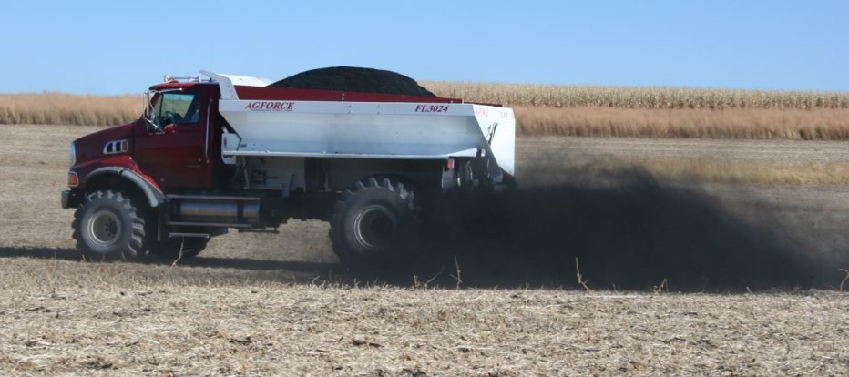
Rules of Thumb
If the standards has a limit it is because there is a risk to human/crop health
If the standard requires a reported value it is so we know what is being applied for planning and nutrient management

Slide 8
Let’s look at some lab reports!
Website for the SCA calculator:
https://www.pnwbiochar.org/tools/tools_336/
Many other resources on the website

